Slide 1
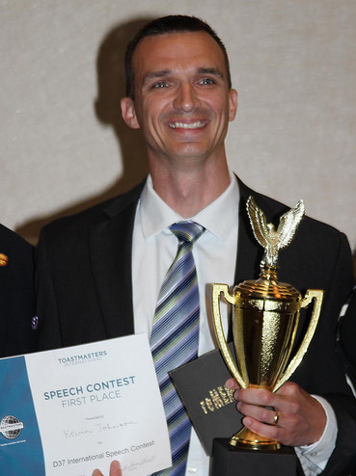
DISTRICT 37
Serving Toastmasters in North Carolina

