Slide 1
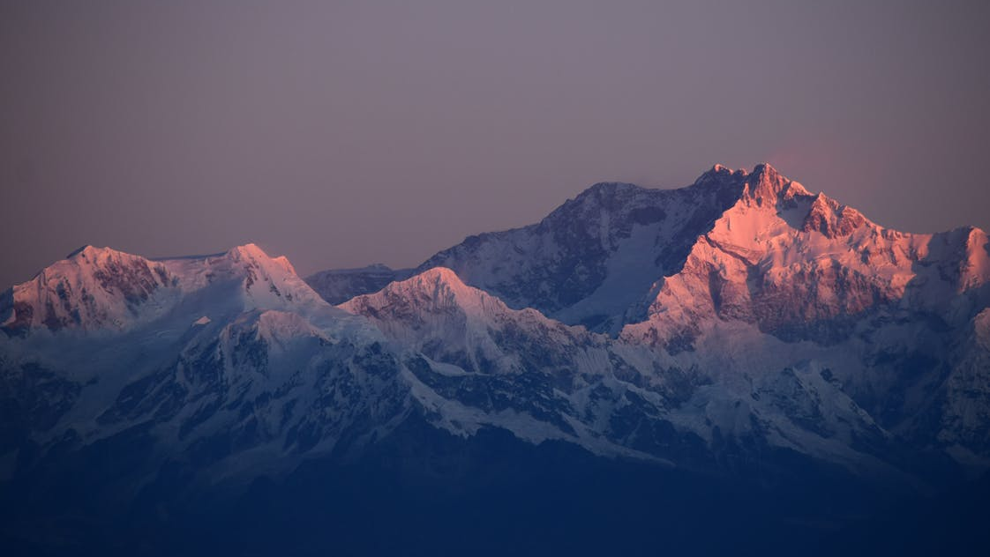
District 37 Conference Agenda
FRIDAY
5:30 – 7:00 PM | Evaluation Contest
7:00 – 8:00 PM | Keynote Presentation: Elmer Hill, DTM
8:00 – 9:00 PM | Networking & Collaboration Sessions
SATURDAY
9:00 – 10:15 AM | Table Topics Contest
10:35 – 11:25 AM | Breakout Sessions: Effective Executive Meetings How to be a Freelance Writer Call for Club Coaches
11:35 AM – 12:25 PM | Keynote Presentation: Dr. Kevin Snyder
1:05 – 1:55 PM | Breakout Sessions: DTM: Demystifying the Mountaintop Elevate Your Social Media Distinguished Toastmasters Reception
2:15 – 4:30 PM | International Speech Contest
4:30 – 4:45 PM | Trio Swearing-in Ceremony & Closing Remarks

