Slide 1
Pathways Base Camp Manager
Presented by
Becky McGilton, DTM, PDD

Slide 2
Agenda
Welcome
Primary Responsibilities
Q&A

Slide 3
Primary Responsibilities
Approve member educational awards in Base Camp
Submit member educational awards in Club Central
Track member progress
Validate meeting role completions
Reward/Recognize member accomplishments

Slide 4
Approving Awards in Base Camp

Slide 5
Email Notification
Base Camp notifications will go to the email listed on Club Central under Club Contact and Meeting Information
In this example, the club has a Gmail account. We use filters and forwarding to make sure the correct people get the Base Camp notifications.
You can also use Free Toast Host to do the forwarding to Base Camp Managers

Slide 6
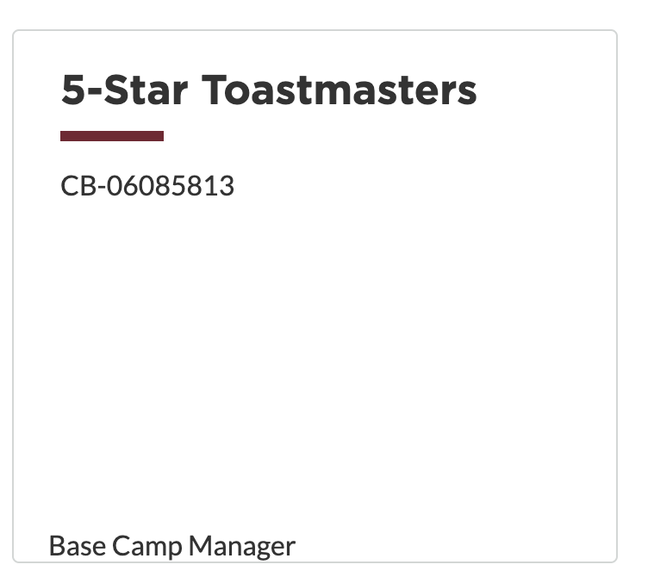
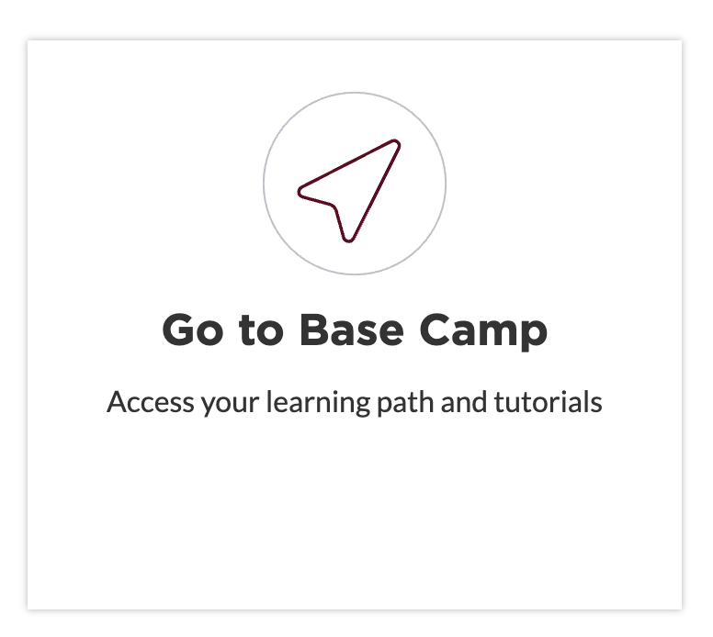
Login to Toastmasters
www.toastmasters.org

Slide 7
Base Camp Manager Home Page

Slide 8
Pending Requests
Pending requests would be listed
Options would be to approve or deny
If you deny the request, be sure to give some reasoning that will allow the member to figure out what is needed for approval

Slide 9
Submitting Awards in Club Central

Slide 10
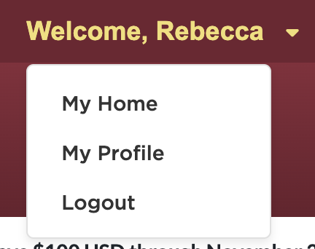
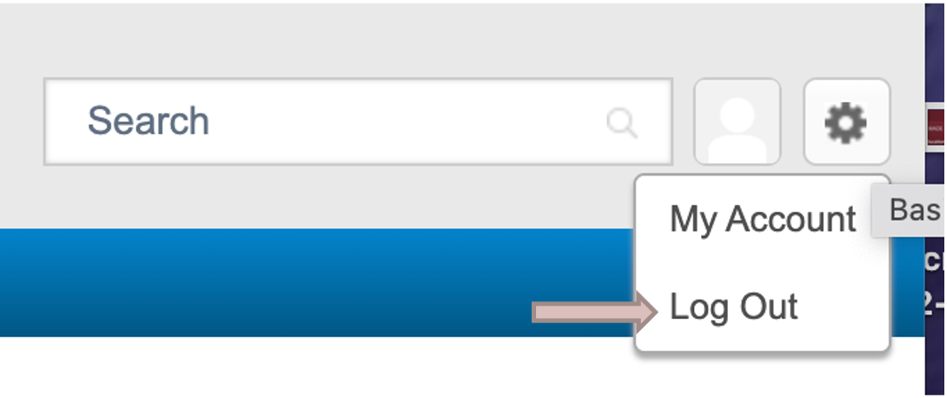
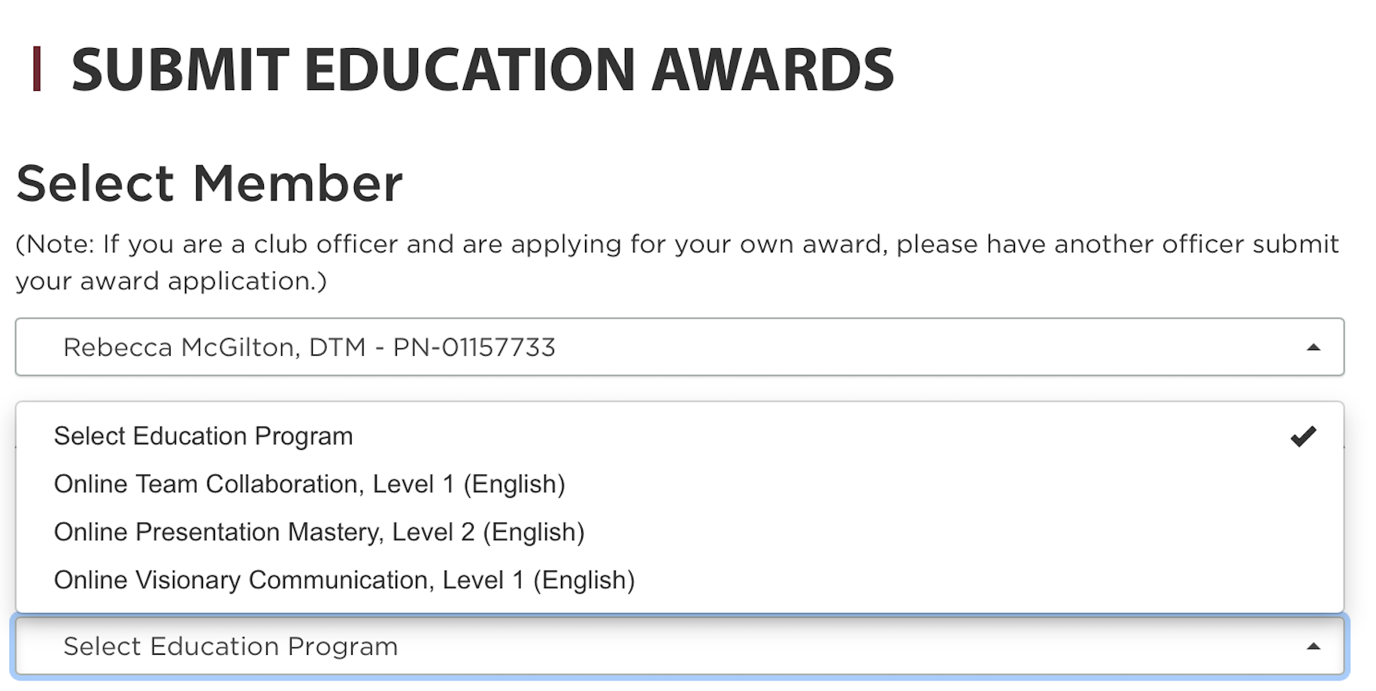
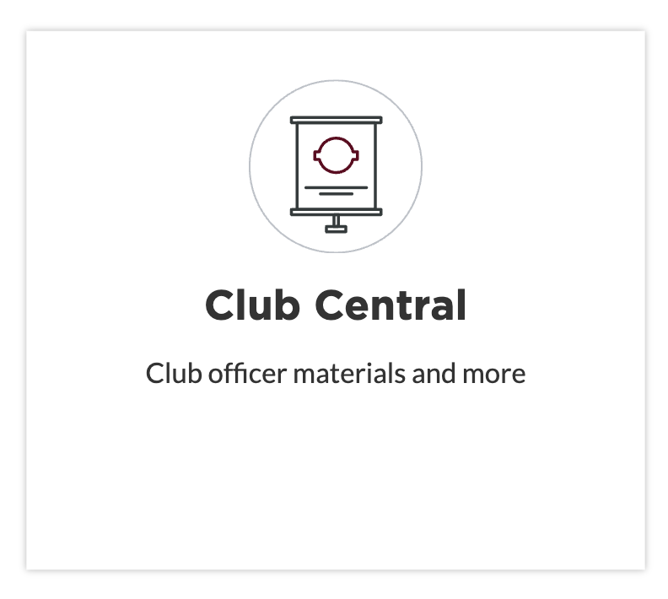
Club Central
* Be sure the award you are selecting in Club Central matches what you approved in Base Camp

Slide 11
Tracking Member Progress

Slide 12
Base Camp Manager Home Page

Slide 13
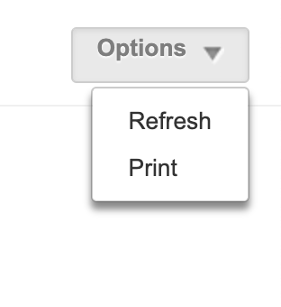
Member Progress
First thing to do is refresh the reports
Individual progress by level
Level completions in the last 90 days
(Online and print)
Status of all paths
(Not started, in process and completed)
Delivery method (Online or print)
Paths selected in the last 30 days
(Online and print)
External Training Requests

Slide 14
Member Progress Reports

Slide 15
Report Details
This is what you will see when you select “View Details.”
You can also “Export to Excel” which gives you better access to manipulate and sort the data.

Slide 16
Base Camp Manager Home Page

Slide 17
Manager Tutorials

Slide 18
Validating Meeting Role Completions

Slide 19
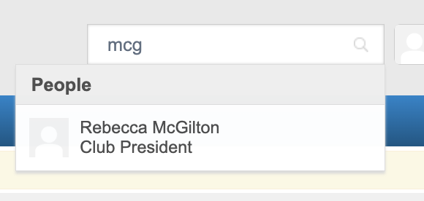
Checking Meeting Roles
Completing Level 3 in a path requires a member to fulfill the roles of evaluator, meeting Toastmaster, and Table Topicsmaster. As Base Camp Manager you should be validating that this step has been completed before approving a Level 3. This requirement can be found on Page 11 of the Navigator.

Slide 20
Viewing Team
Note: If a member is not showing in the list, chances are they are a dual member and are not currently logged in to the club.

Slide 21
Rewarding/Recognizing Member Accomplishments

Slide 22
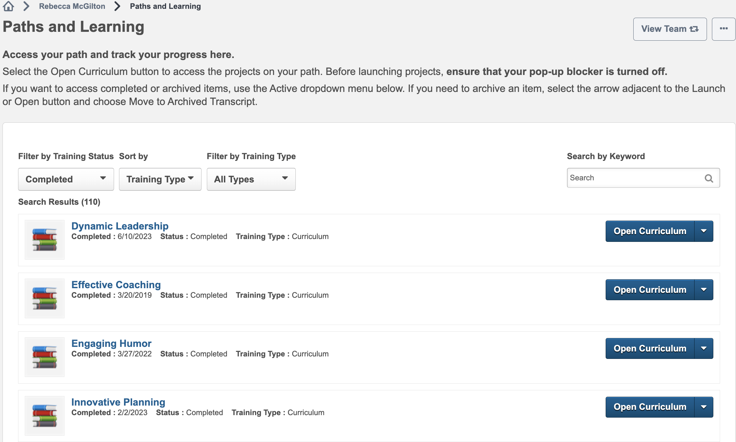
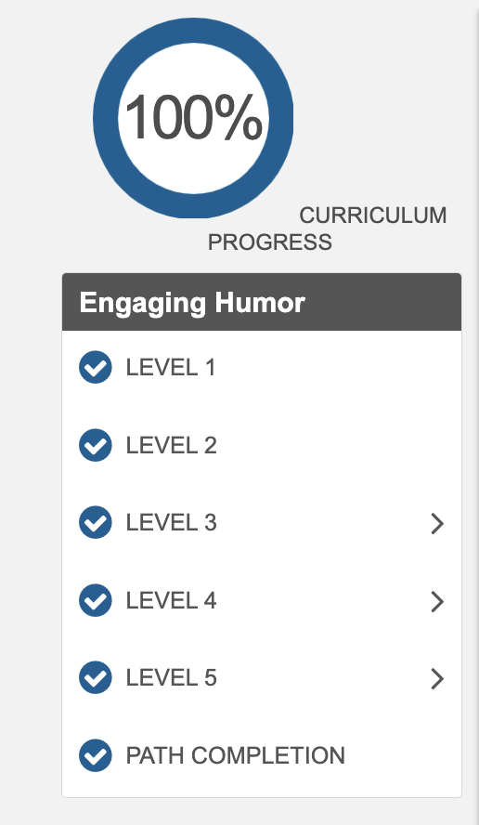
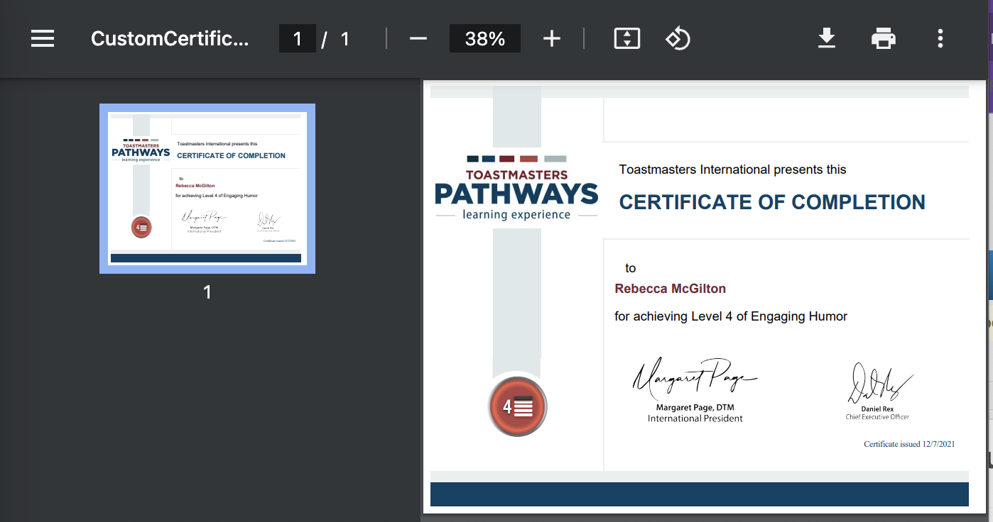
Downloading/Printing Certificates

Slide 23
Q & A

